Slide 1
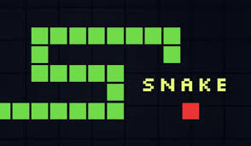
The Game of Snake
Snake is a classic video game with the goal to eat as much food as you can to grow your snake in hopes of filling out the entire screen.
Luke Bracknell

